Slide 1
Project-1
STARTED ON :20/02/2025 ENDED ON :21/02/2025
Created By
P.PRASANTH

Slide 2
Deploy swiggy application by using Jenkins && docker

Slide 3
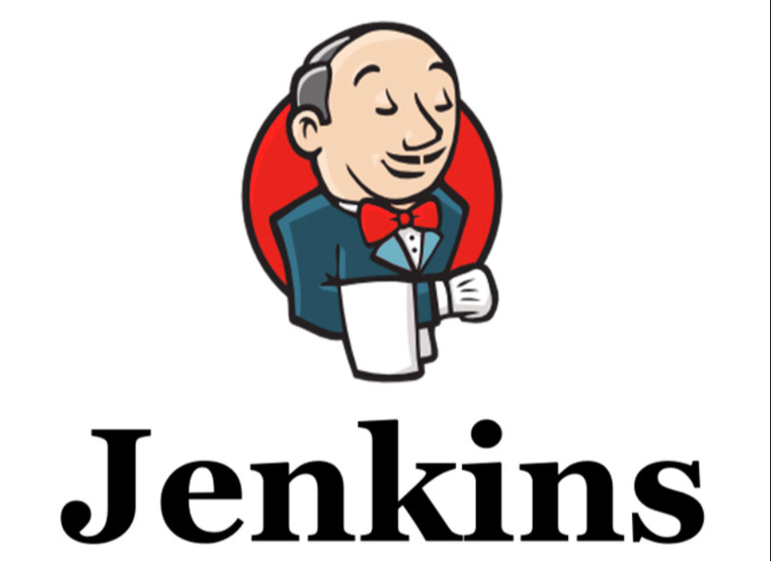

Slide 4
What is Jenkins?
Jenkins is a tool that is used for automation. It is mainly an open-source server that allows all the developers to build, test and deploy software. It is written in Java and runs on java only. By using Jenkins we can make a continuous integration of projects(jobs) or end-to-endpoint automation

Slide 5
Why Organizations use Jenkins?
Jenkins facilitates the automation of several stages of the software development lifecycle, including application development, testing, and deployment. Operating within servlet containers like Apache Tomcat, the technology is server- based. Continuous delivery (CD) and integration (CI) pipelines can be created and managed with Jenkins. The development, testing, and deployment of software applications are automated using CI/CD pipelines. You will be able to release software more regularly and with fewer problems if you do this.
jenkins is flexible.
You can add the n no .of plugins you want to add to the jenkins.
You can automate the proceses of CI/CD pipelines of all the projects.

Slide 6
What is Jenkins CI/CD Pipeline?
Jenkins CI/CD stands for Continuous Integration / Continuous Deployment first let us try to understand what is a pipeline. In computing, a pipeline is a set of stages or processes linked together to form a processing system. Each stage in the pipeline takes an input, processes it in accordance with a set of rules, and then sends the outputs to the stage that follows. Frequently, the pipeline’s overall output is its final step’s output. like the procedures outlined below
Test code
Build Application
Push Repository
Deploy to Server

Slide 7
What is Jenkins Continuous Integration (CI)?
Jenkins Continuous integration means whenever new code is committed to remote repositories like GitHub, GitLab, etc. Continuous Integration (CI) will continuously build, tested, and merged into a shared repository.
Benefits of Continuous Integration (CI)
We can maintain the reports of the projects
Deployments can be made within the given time
Bugs can be found quickly

Slide 8
What is Jenkins Continuous Deployment/Delivery (CD)?
Continuous Deployment
Continuous Deployment means automating the further stages of the pipeline automatically or manually deploying the application/code to different environments like Dev, Test, and Production. Automating the build is the main component of Continuous Integration and Continuous Deployment.
Continuous Delivery
Each and every build that passed all automated tests and was able to be fully automated and delivered into production only required one click of human intervention is called Continuous Delivery.

Slide 9
Advantages and Disadvantages of Jenkins
Advantages of Jenkins
Disadvantages of Jenkins
Automates build, test, and deployment processes.
Supports continuous integration and continuous.
delivery (CI/CD) pipelines.
Provides extensive plugin ecosystem for customization.
Facilitates collaboration and team productivity.
Enables monitoring and reporting of build statuses.
Helps in detecting and fixing bugs early.
Requires initial setup and configuration.
Can be complex to manage for large projects or teams.
Requires dedicated infrastructure and maintenance.
May encounter plugin compatibility issues.
Steeper learning curve for beginners.
Can lead to dependency on automation.
May require additional resources for optimal performance.
Risk of security vulnerabilities if not properly configured.

Slide 10
Docker

Slide 11
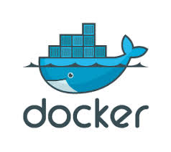

Slide 12
What is Docker?
Docker is an open-source containerization platform by which you can pack your application and all its dependencies into a standardized unit called a container. Containers are light in weight which makes them portable and they are isolated from the underlying infrastructure and from each other container. You can run the docker image as a docker container in any machine where docker is installed without depending on the operating system.

Slide 13
Why Docker is popular?
Docker gained its popularity due to its impact on the software development and deployment. The following are the some of the main reasons for docker becoming popular:
Portability: Docker facilitates the developers in packaging their applications with all dependencies into a single lightweight containers. It facilities in ensuring the consistent performance across the different computing environments.
Reproducibility: Through encapsulating the applications with their dependencies within a container it ensures in software setups remaining consistent across the development, testing and production environments.
Efficiency: Docker through its container based architecture it optimizes the resource utilization. It allows the developers to run the multiple isolated applications on a single host system.
Scalability: Docker’s scalability features facilitated the developers in making easier of their applications handling at time of workloads increment.

Slide 14
Key Components of Docker
The following are the some of the key components of Docker:
Docker Engine: It is a core part of docker, that handles the creation and management of containers.
Docker Image: It is a read-only template that is used for creating containers, containing the application code and dependencies.
Docker Hub: It is a cloud based repository that is used for finding and sharing the container images.
Docker file: It is a script that containing instructions to build a docker image.
Docker Registry : It is a storage distribution system for docker images, where you can store the images in both public and private modes.

Slide 15
What is Docker Architecture and How Docker Works?
Docker makes use of a client-server architecture. The Docker client talks with the docker daemon which helps in building, running, and distributing the docker containers. The Docker client runs with the daemon on the same system or we can connect the Docker client with the Docker daemon remotely. With the help of REST API over a UNIX socket or a network, the docker client and daemon interact with each other. To know more about working of docker refer to the Architecture of Docker .

Slide 16
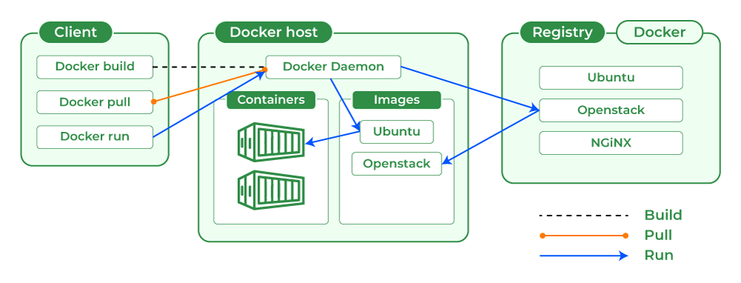
Docker Architecture

Slide 17
Docker Commands
Docker Run: It used for launching the containers from images, with specifying the runtime options and commands.
Docker Pull: It fetches the container images from the container registry like Docker Hub to the local machine.
Docker ps : It helps in displaying the running containers along with their important information like container ID, image used and status.
Docker Stop : It helps in halting the running containers gracefully shutting down the processes within them.
Docker Start: It helps in restarting the stopped containers, resuming their operations from the previous state.
Docker Login: It helps to login in to the docker registry enabling the access to private repositories.

Slide 18
Use Cases of Docker
Continuous Integration and Continuous Deployment (CI/CD) : It helps in streamlining and automating the software delivery process with ensuring faster and more reliable releases.
Microservices Architecture: It facilitates the development, deployment, and management of microservices with enabling independent scaling and maintenance.
Development Environment Consistency: It will ensures with consistent development, testing, and production environments, reducing “it works on my machine” issues.
Multi-Cloud and Hybrid Cloud Deployments: It helps in simplifying the application deployment across various cloud platforms, enhancing flexibility and reducing vendor lock-in.

Slide 19
Sonarqube && sonar analysis

Slide 20
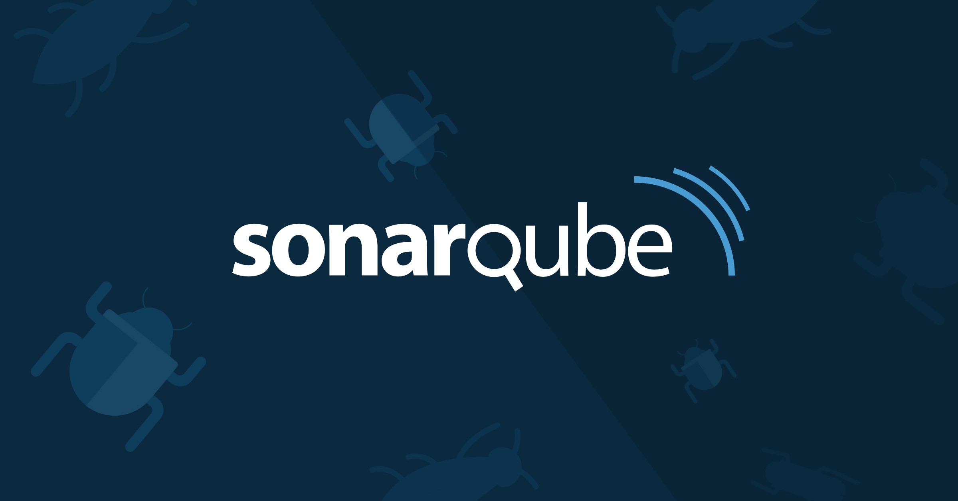

Slide 21
What is SonarQube?
SonarQube identifies bugs, vulnerabilities, and code smells through source code analysis. This tool enforces good coding standards and best practices on projects for better consistency and readability. All these lead to full quality assurance in software project delivery, fewer defects, greater maintainability, and added security.

Slide 22
Why SonarQube is Important?
SonarQube is a powerful platform, playing a critical role for both the quality and maintainability of software projects. Complete suites for continuous source code inspection enable developers to find issues right from the start of the development process, which in turn changes the quality of the corresponding code base very quickly. Below, we describe major reasons why SonarQube is such an essential tool for modern software development teams.
Improved Code Quality
Enhanced Code Maintainability
Improved Security
Enhanced Collaboration
Increased Productivity
Compliance Adherence
Risk Mitigation

Slide 23
What is sonar analysis?
Sonar is a static code analysis tool, a tool that scans your code and tries to detect flaws, bugs, security vulnerabilities, etc. It can also measure test coverage of your code if provided with proper reports. All these features focus on direct code development and help developers build better products.

Slide 24
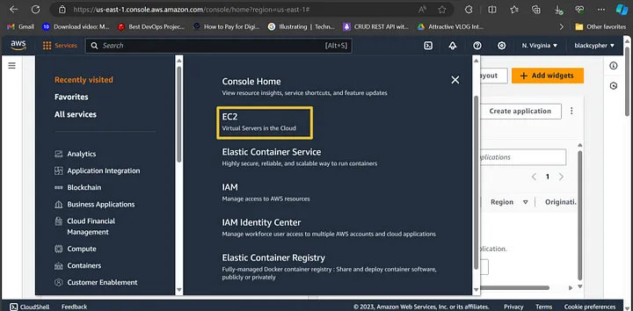
Step 1 — Create an EC2 instance

Slide 25
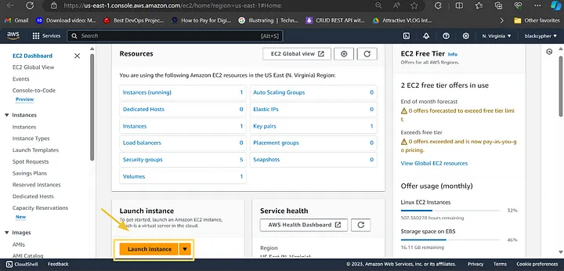
Click “Launch Instance” to begin the process of creating an EC2 instance.

Slide 26
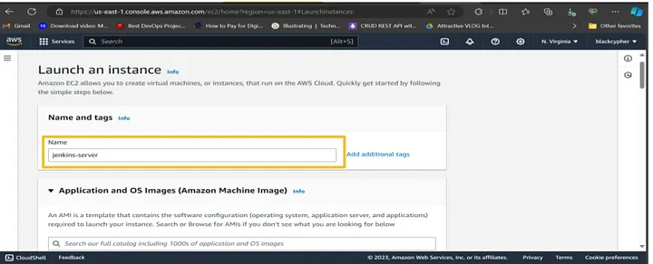
Give the instance a name

Slide 27
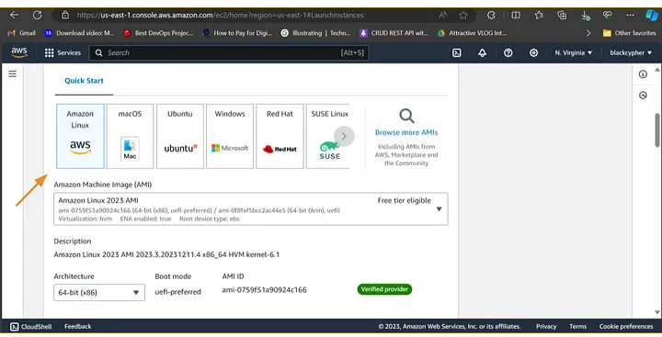
Choose the Amazon machine image which should be selected by default.

Slide 28
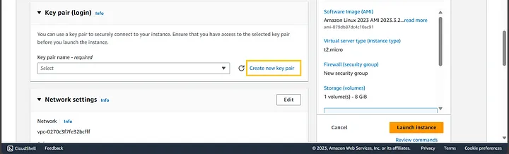
In the configure key pair step, you have the option of selecting an existing key pair or creating a new one as shown in the image below:

Slide 29
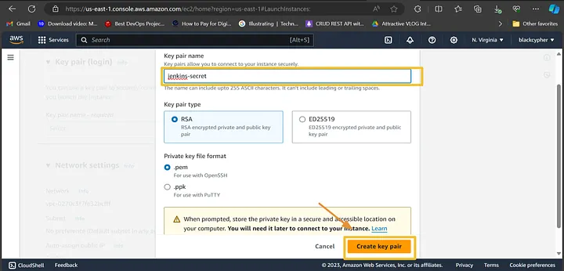

Slide 30
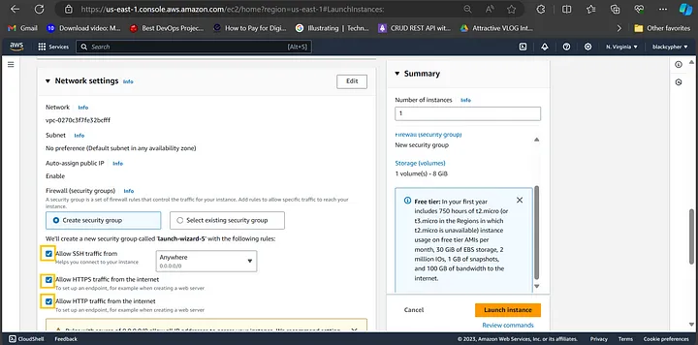
In the network settings, you can select an existing security group or create a new one as shown in the image below:

Slide 31
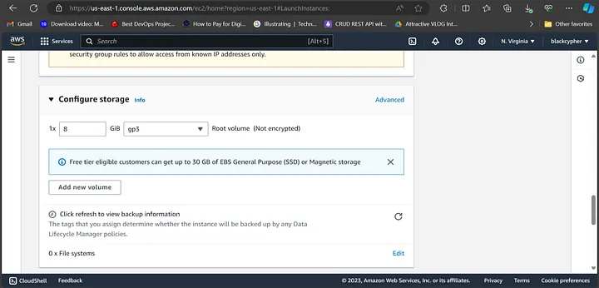
Configure storage should be set by default

Slide 32
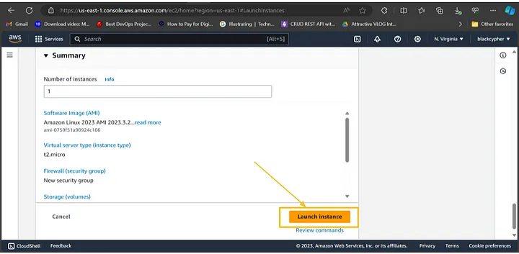
In the summary you can review the setup configuration. Then, click launch instance to start an EC2 instance.

Slide 33
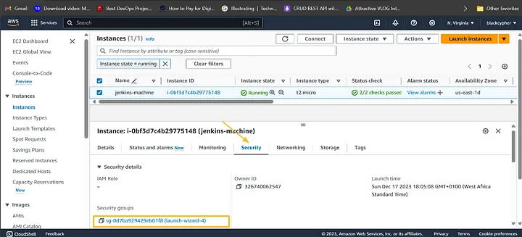
Step 2 — Configure security group

Slide 34
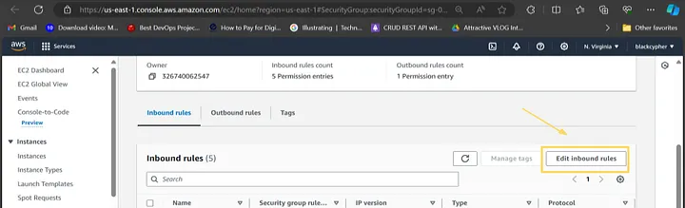
Select the Edit inbound rules

Slide 35
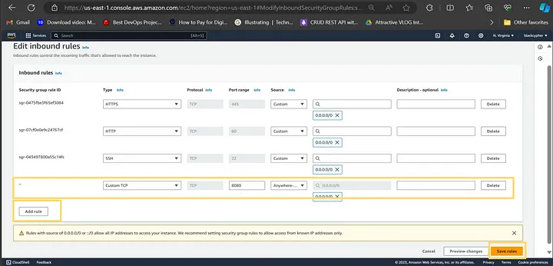
click Add rule then add the rule as highlighted in the image below. Then click the save rules to apply the changes

Slide 36
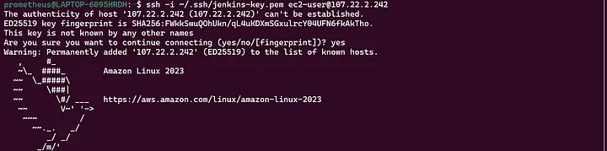
Step 3 — Connect your EC2 instance using ssh

Slide 37
Jenkins installation path
sudo wget -O /usr/share/keyrings/jenkins-keyring.asc \
https://pkg.jenkins.io/debian-stable/jenkins.io-2023.key
echo "deb [signed-by=/usr/share/keyrings/jenkins-keyring.asc]" \
https://pkg.jenkins.io/debian-stable binary/ | sudo tee \
/etc/apt/sources.list.d/jenkins.list > /dev/null
sudo apt-get update
sudo apt-get install fontconfig openjdk-17-jre
sudo apt-get install jenkins

Slide 38
sudo systemctl start jenkins
sudo systemctl enable jenkins
sudo systemctl status Jenkins
When we stop the instance again we can start instance using these commands
sudo systemctl daemon-reload
sudo systemctl restart jenkins.service
sudo systemctl status jenkins.service
MAVEN INSTALLATION
sudo apt install Maven -y
mvn –versión

Slide 39
Docker installation path
sudo apt-get update
sudo apt-get install docker.io -y
sudo usermod -aG docker $USER
newgrp docker
sudo chmod 777 /var/run/docker.sock
docker run -d --name sonar -p 9000:9000 sonarqube:lts-community

Slide 40
TRIVY INSTALLATION
sudo apt-get install wget apt-transport-https gnupg lsb-release -y
wget -qO - https://aquasecurity.github.io/trivy-repo/deb/public.key | gpg --dearmor | sudo tee /usr/share/keyrings/trivy.gpg > /dev/null
echo "deb [signed-by=/usr/share/keyrings/trivy.gpg] https://aquasecurity.github.io/trivy-repo/deb $(lsb_release -sc) main" | sudo tee -a /etc/apt/sources.list.d/trivy.list
sudo apt-get update –y
sudo apt-get install trivy -y

Slide 41
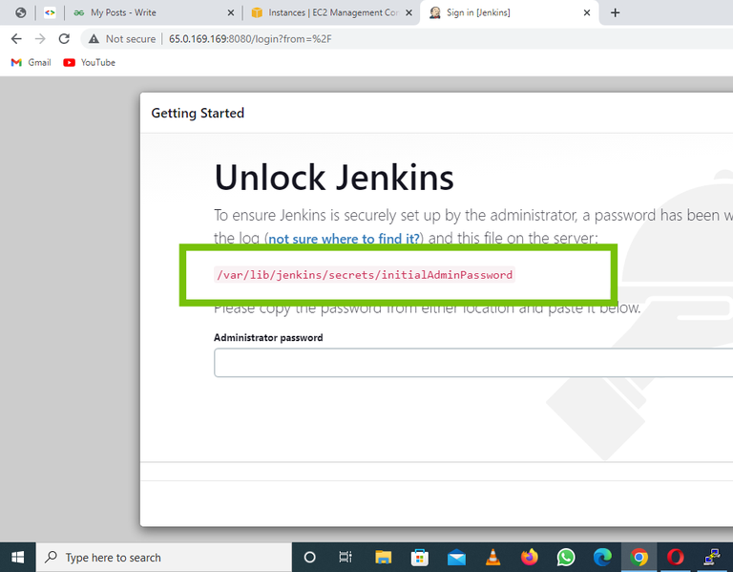

Slide 42
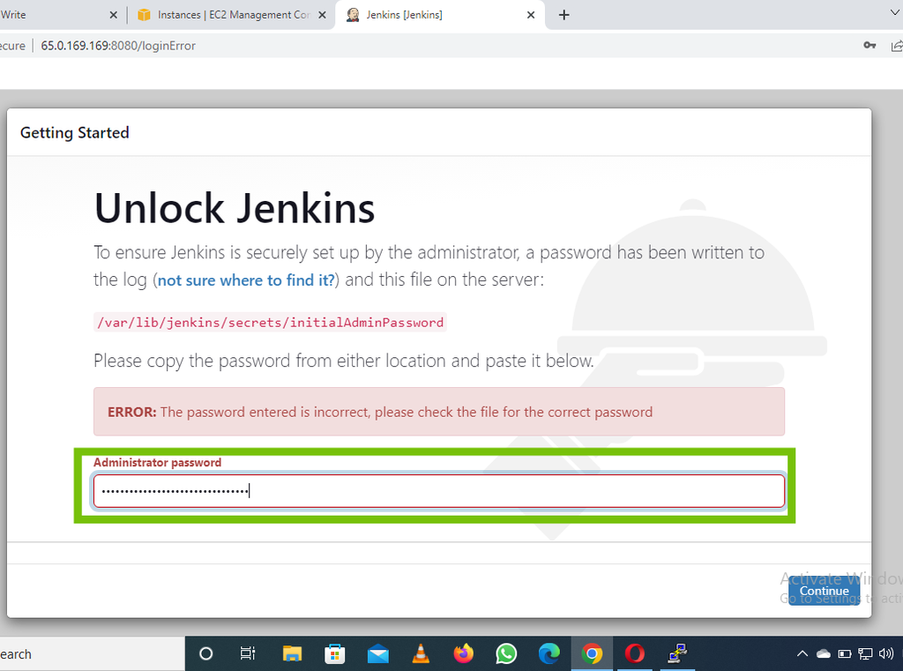

Slide 43
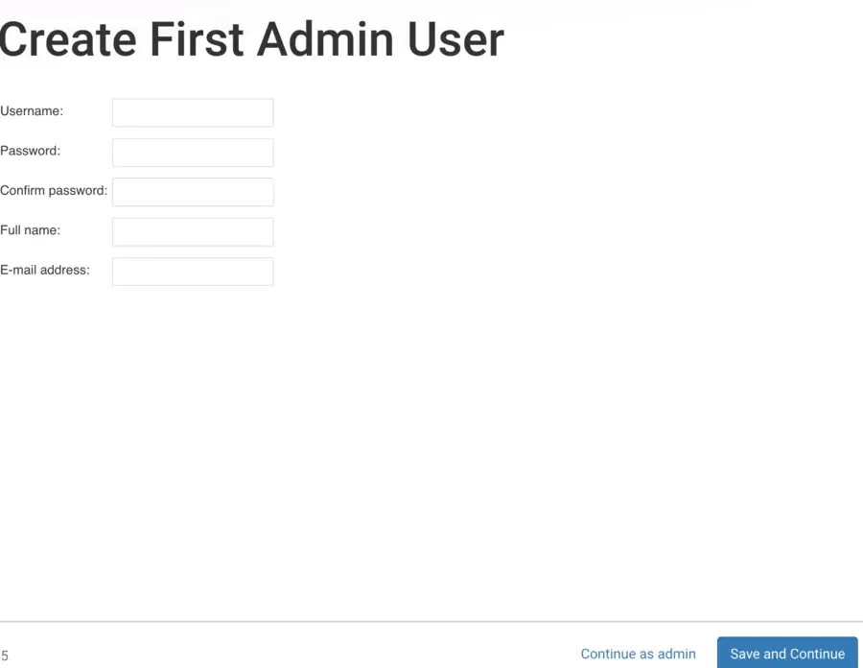

Slide 44
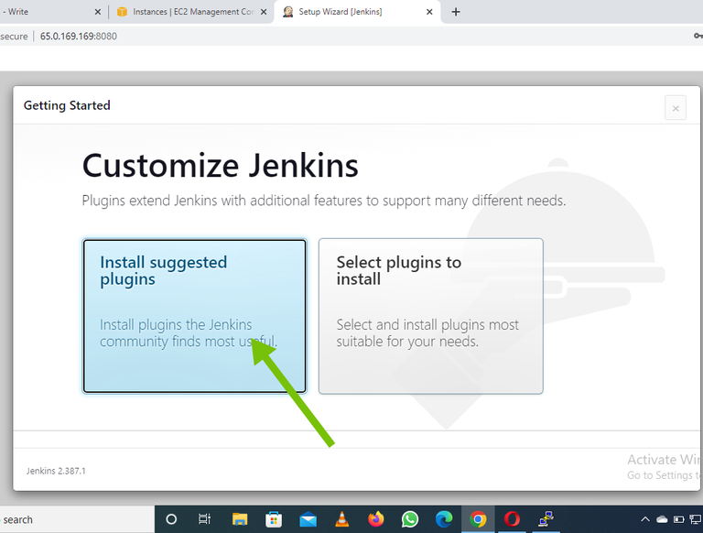

Slide 45
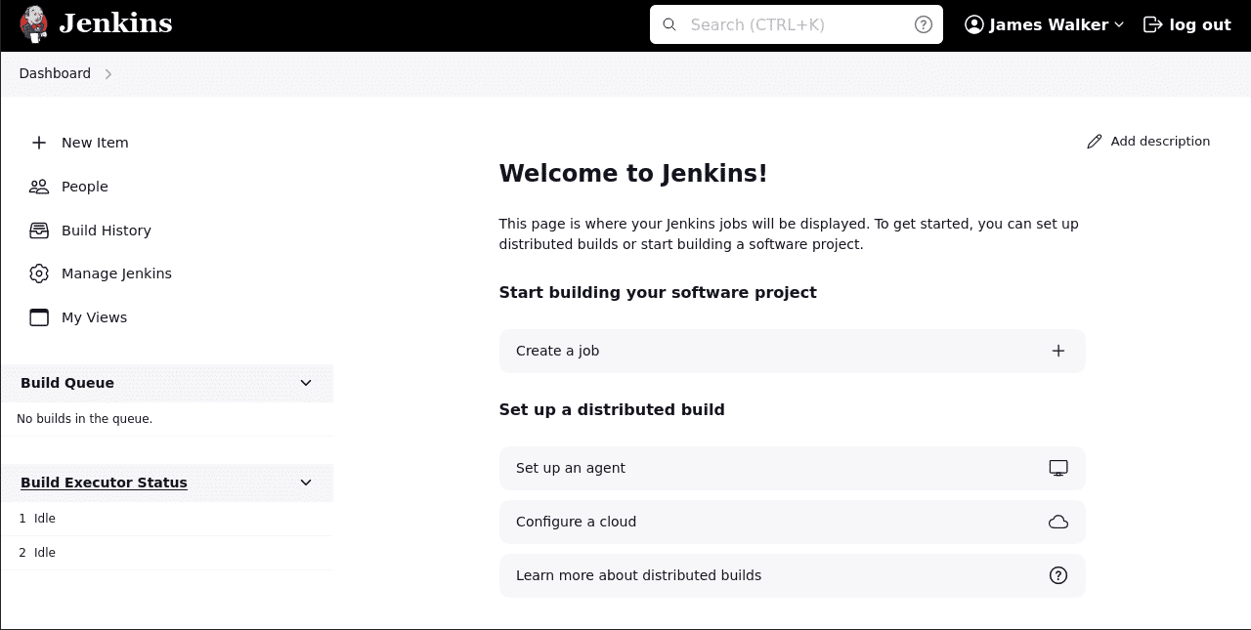
Step 1: Log in to the Jenkins dashboard

Slide 46
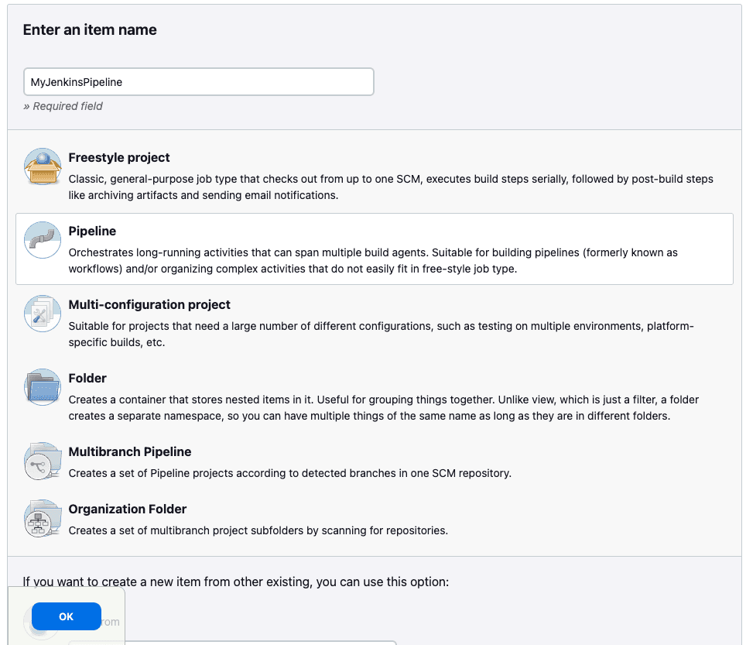
Step 2: Create the Jenkins pipeline

Slide 47
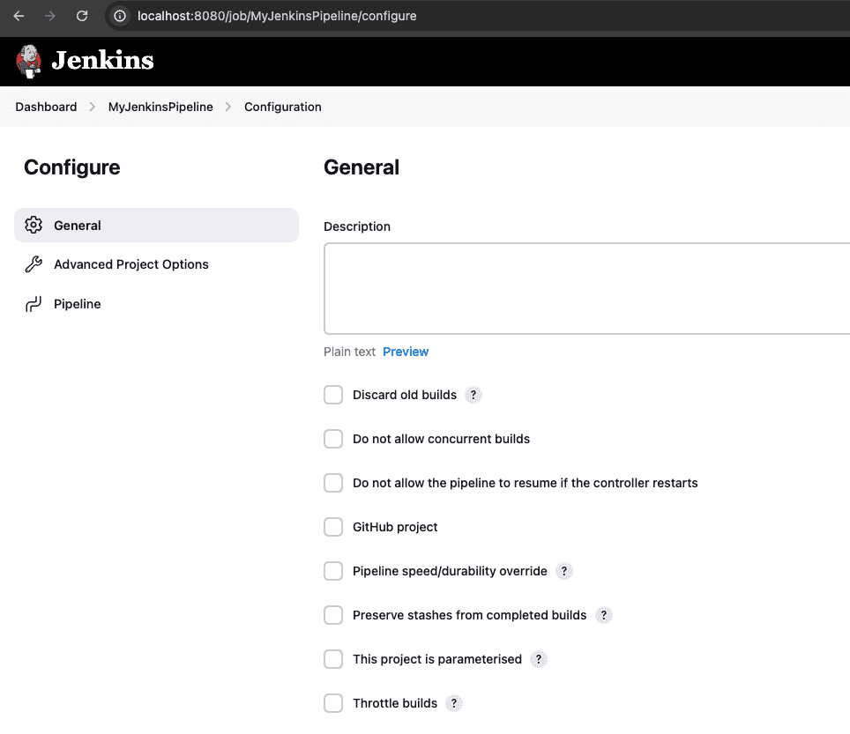
Step 3: Configure pipeline options

Slide 48
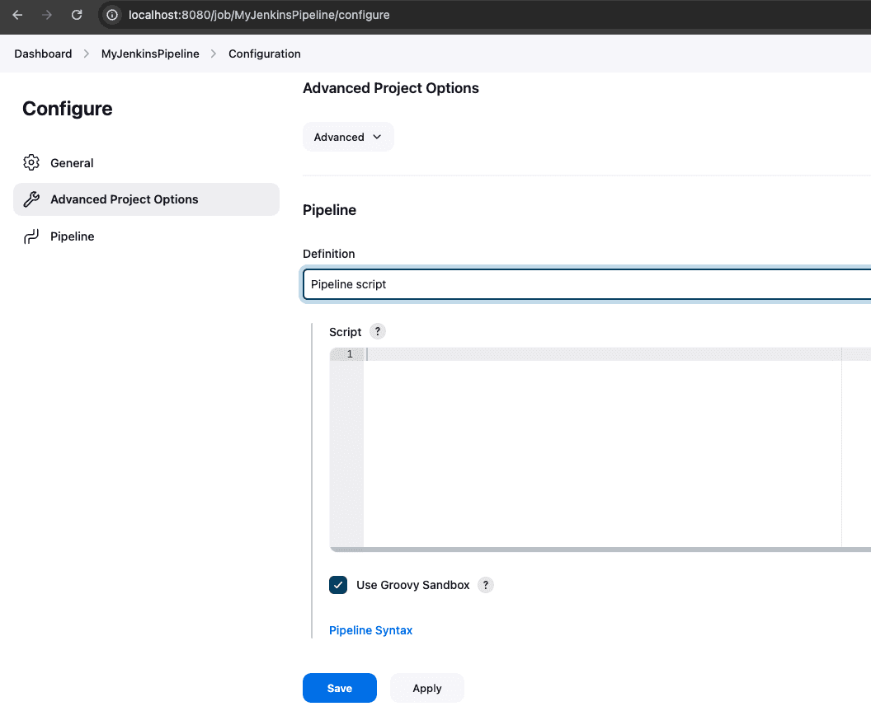
Step 4: Create a pipeline script

Slide 49
SWIGGY CI/CD PIPELINE

Slide 50
pipeline {
agent any
tools {
jdk 'jdk17'
nodejs 'node23'
}
environment {
SCANNER_HOME = tool 'sonar-scanner'
}
stages {
stage('Clean Workspace') {
steps {
cleanWs()
}
}
stage('Checkout from Git') {
steps {
git ‘https://github.com/9160882192/prasanth22.git'
}
}

Slide 51
stage('SonarQube Analysis') {
steps {
withSonarQubeEnv('sonar-server') {
sh '''
$SCANNER_HOME/bin/sonar-scanner \
-Dsonar.projectName=swiggy-app \
-Dsonar.projectKey=swiggy-app
'''
}
}
}
stage('Quality Gate') {
steps {
script {
waitForQualityGate abortPipeline: false, credentialsId: 'sonar-token'
}
}
}

Slide 52
stage('Install Dependencies') {
steps {
sh 'npm install'
}
}
stage('OWASP FS SCAN') {
steps {
dependencyCheck additionalArguments: '--scan ./ --disableYarnAudit --disableNodeAudit', odcInstallation: 'DP-Check'
dependencyCheckPublisher pattern: '**/dependency-check-report.xml'
}
}
stage('TRIVY FS SCAN') {
steps {
sh 'trivy fs . > trivyfs.txt'
}
}
stage('Docker Login') {
steps {
withCredentials([usernamePassword(credentialsId: 'docker-creds', passwordVariable: 'mypasswd', usernameVariable: 'usr')]) {
sh 'docker logout'
sh 'echo ${mypasswd} | docker login -u ${usr} --password-stdin'
}
}
}

Slide 53
stage('Build Docker') {
steps {
sh 'docker build -t swiggy-app .'
sh 'docker tag swiggy-app prasanth916/swiggy-app:latest'
}
}
stage('Push to DockerHub') {
steps {
sh 'docker push prasanth916/swiggy-app:latest'
}
}
stage('Deploy to Container') {
steps {
sh 'docker run -d --name swiggy-app -p 3000:3000 prasanth916/swiggy-app:latest'
}
}
}
}

Slide 54
ZOMATO CI/CD PIPELINE

Slide 55
pipeline {
agent any
tools {
jdk 'jdk17'
nodejs 'node23'
}
environment {
SCANNER_HOME = tool 'sonar-scanner'
}
stages {
stage("Clean Workspace") {
steps {
cleanWs()
}
}

Slide 56
stage("Git Checkout") {
steps {
git 'https://github.com/KastroVKiran/Zomato-Project-Kastro.git'
}
}
stage("SonarQube Analysis") {
steps {
withSonarQubeEnv('sonar-server') {
sh '''
$SCANNER_HOME/bin/sonar-scanner -Dsonar.projectName=zomato-app \
-Dsonar.projectKey=zomato-app
'''
}
}
}

Slide 57
stage("Code Quality Gate") {
steps {
script {
waitForQualityGate abortPipeline: false, credentialsId: 'sonar-token'
}
}
}
stage("Install NPM Dependencies") {
steps {
sh "npm install"
}
}

Slide 58
stage("OWASP FS Scan") {
steps {
dependencyCheck additionalArguments: '--scan ./ --disableYarnAudit --disableNodeAudit', odcInstallation: 'DP-Check'
dependencyCheckPublisher pattern: '**/dependency-check-report.xml'
}
}
stage("Trivy File Scan") {
steps {
sh "trivy fs . > trivy.txt"
}
}
stage("Build Docker Image") {
steps {
sh "docker build -t zomato-app ."
}
}

Slide 59
stage("Tag & Push to DockerHub") {
steps {
script {
withDockerRegistry(credentialsId: 'docker-creds') {
sh "docker tag zomato-app varaprasad372/zomato-app:latest"
sh "docker push varaprasad372/zomato-app:latest"
}
}
}
}
stage("Deploy to Container") {
steps {
sh 'docker run -d --name zomato -p 3000:3000 varaprasad372/zomato-app:latest'
}
}
}
}

Slide 60
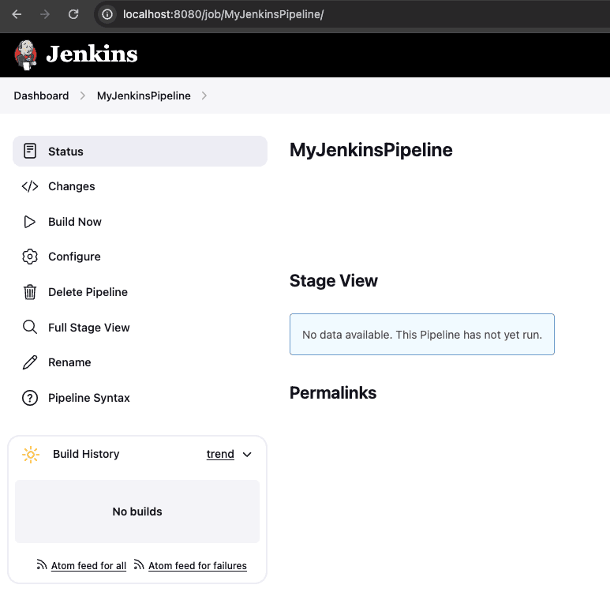
Step 5: Trigger the pipeline manually

Slide 61
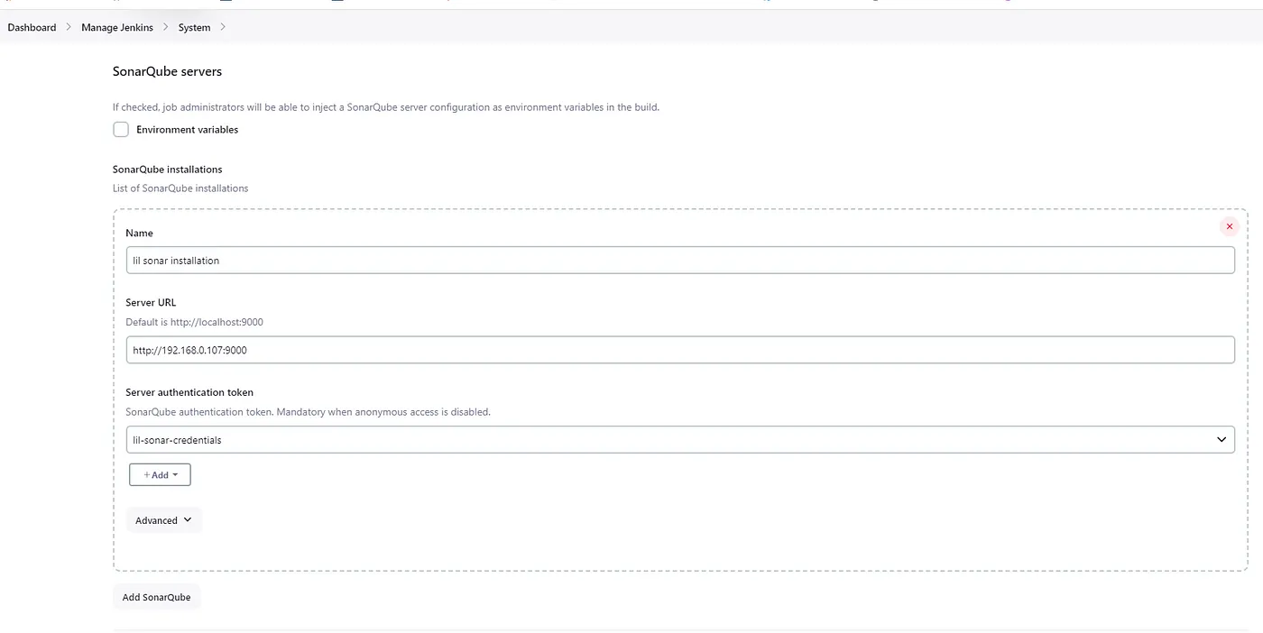

Slide 62
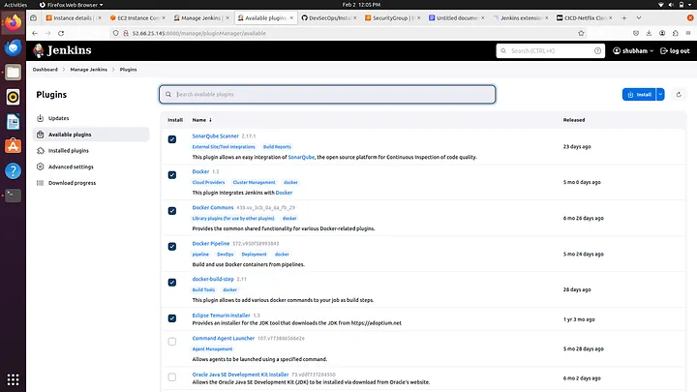

Slide 63
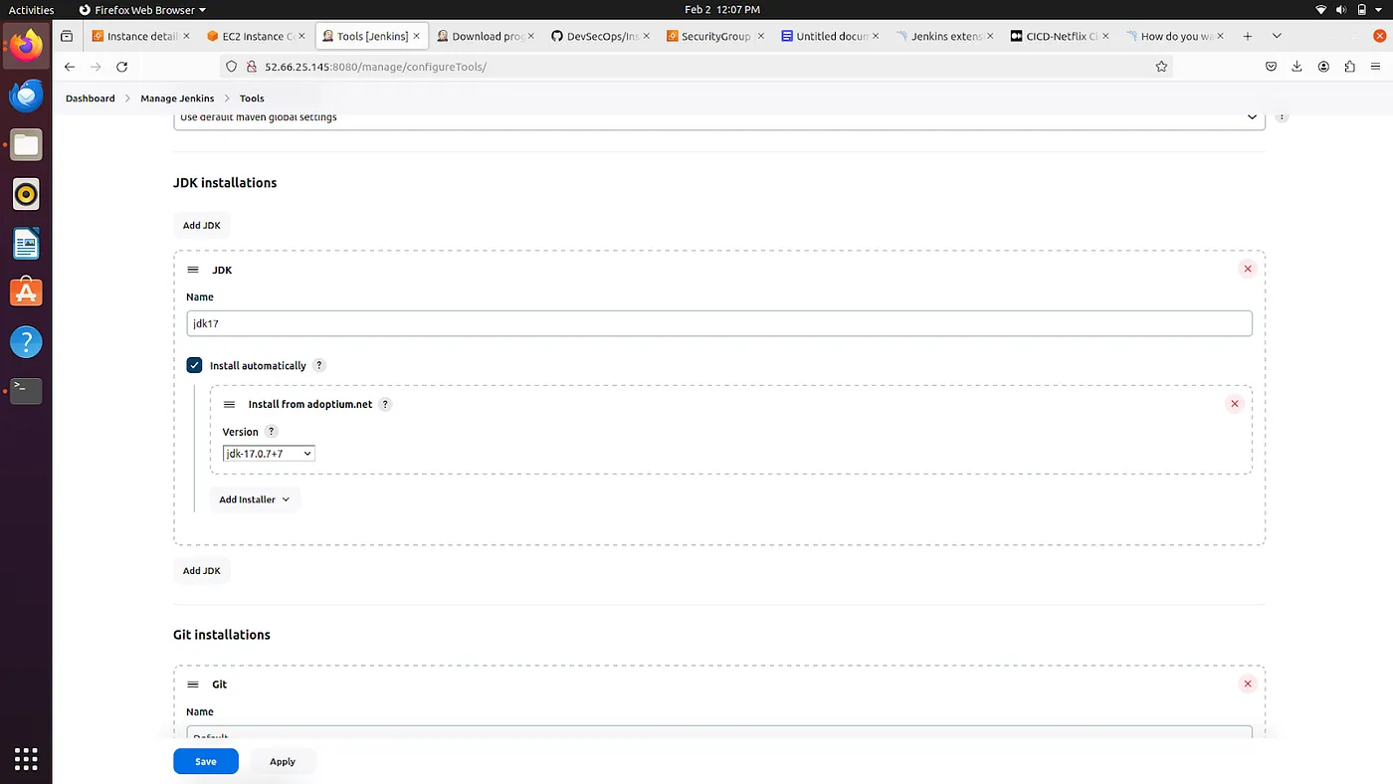

Slide 64
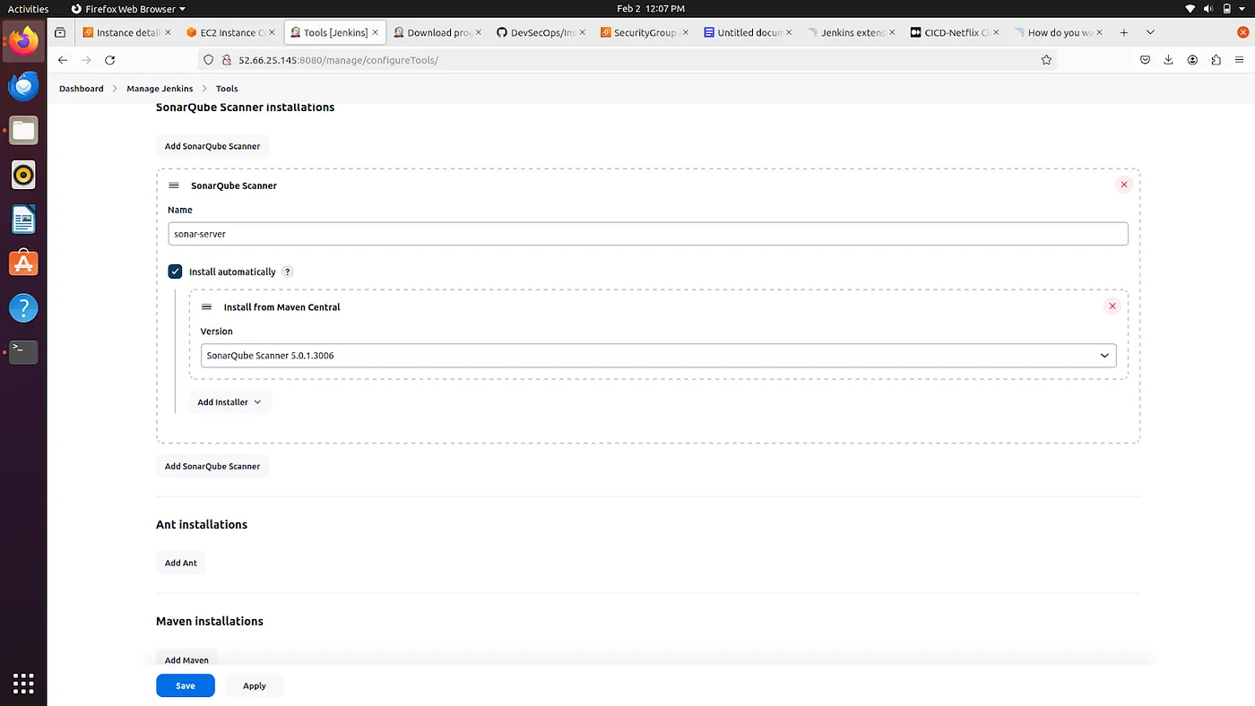

Slide 65
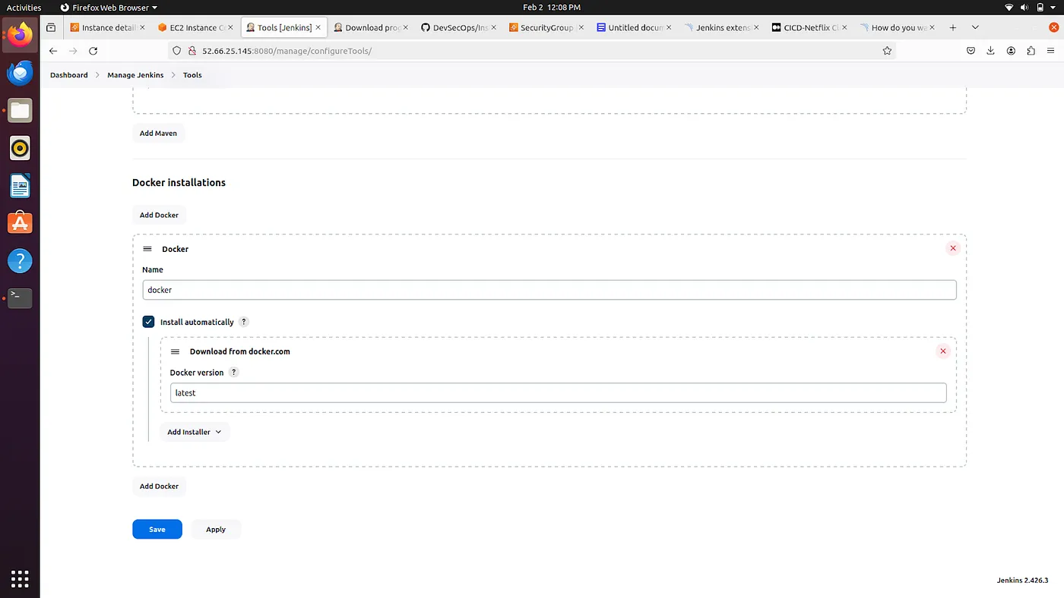

Slide 66
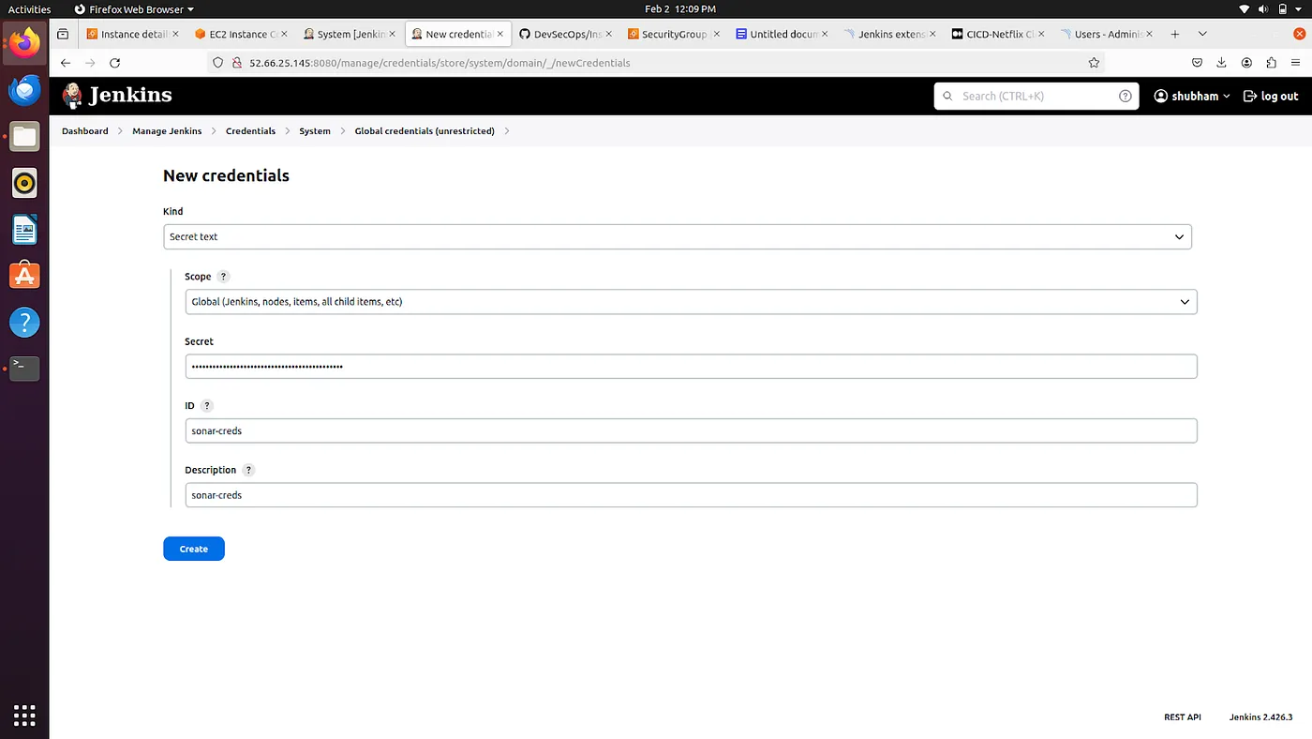

Slide 67
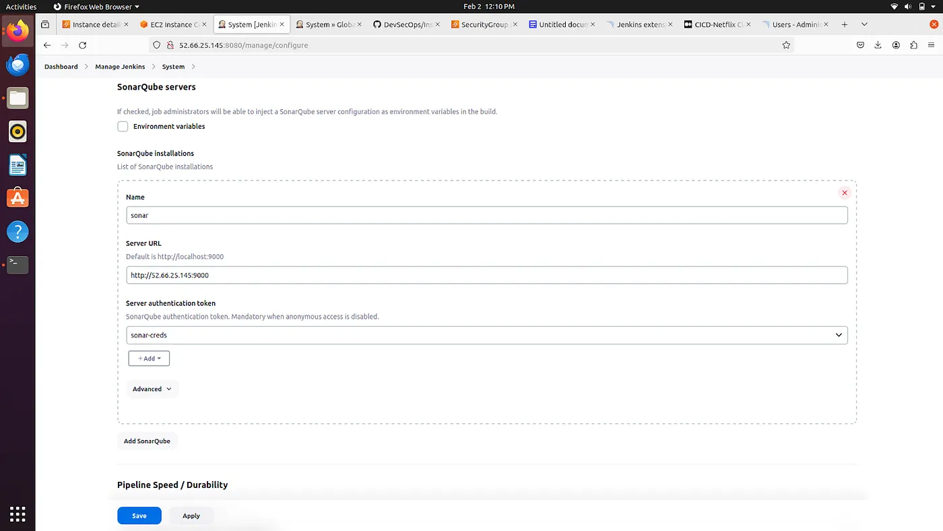

Slide 68
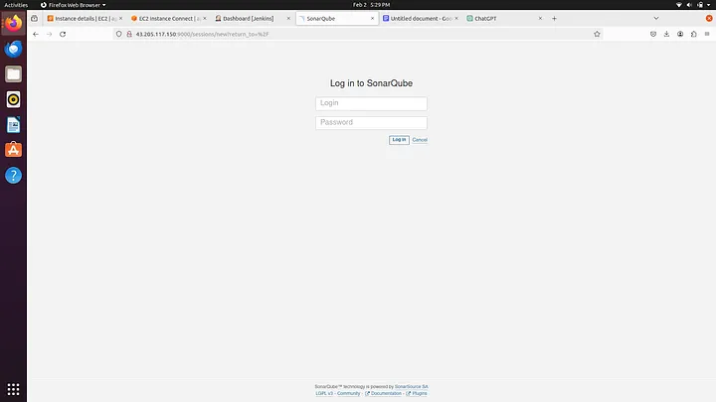

Slide 69
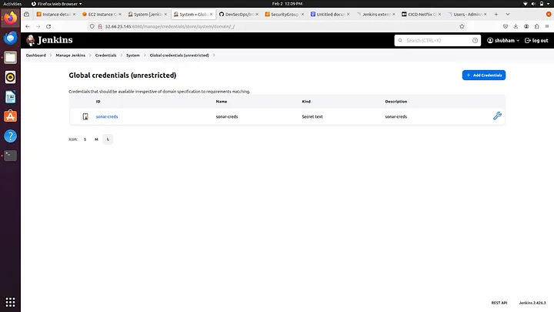

Slide 70
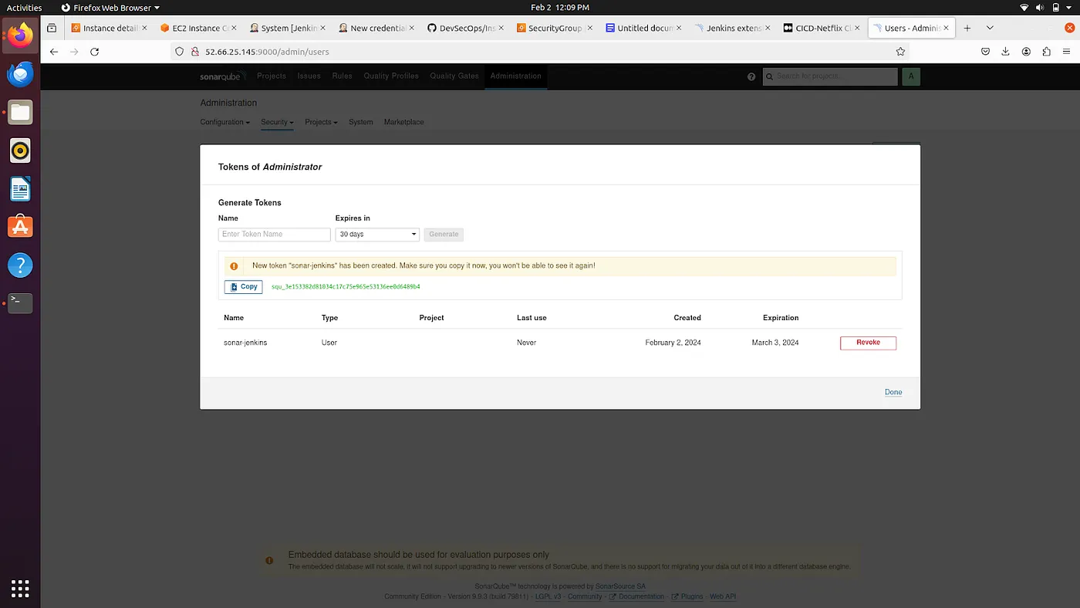

Slide 71
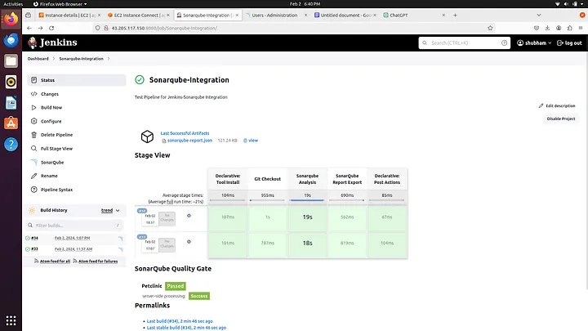

Slide 72
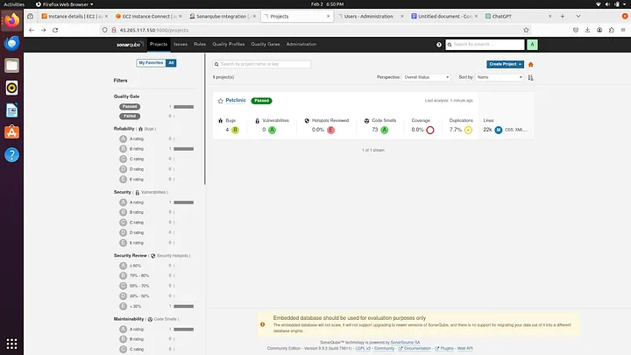

Slide 73
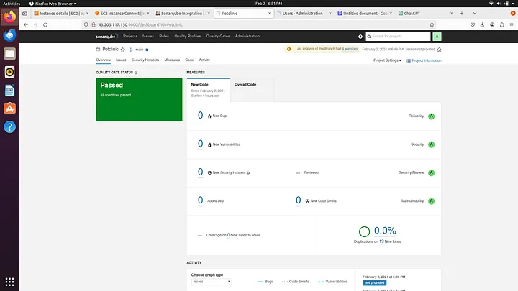

Slide 74
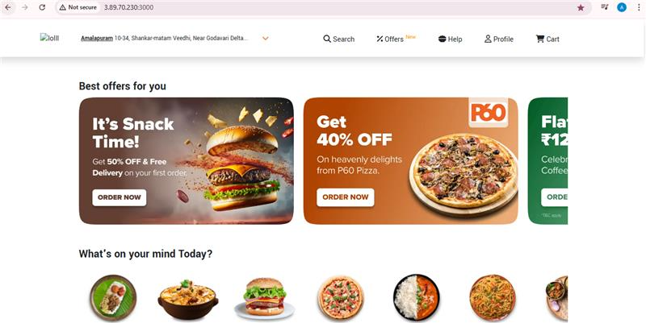


Slide 75
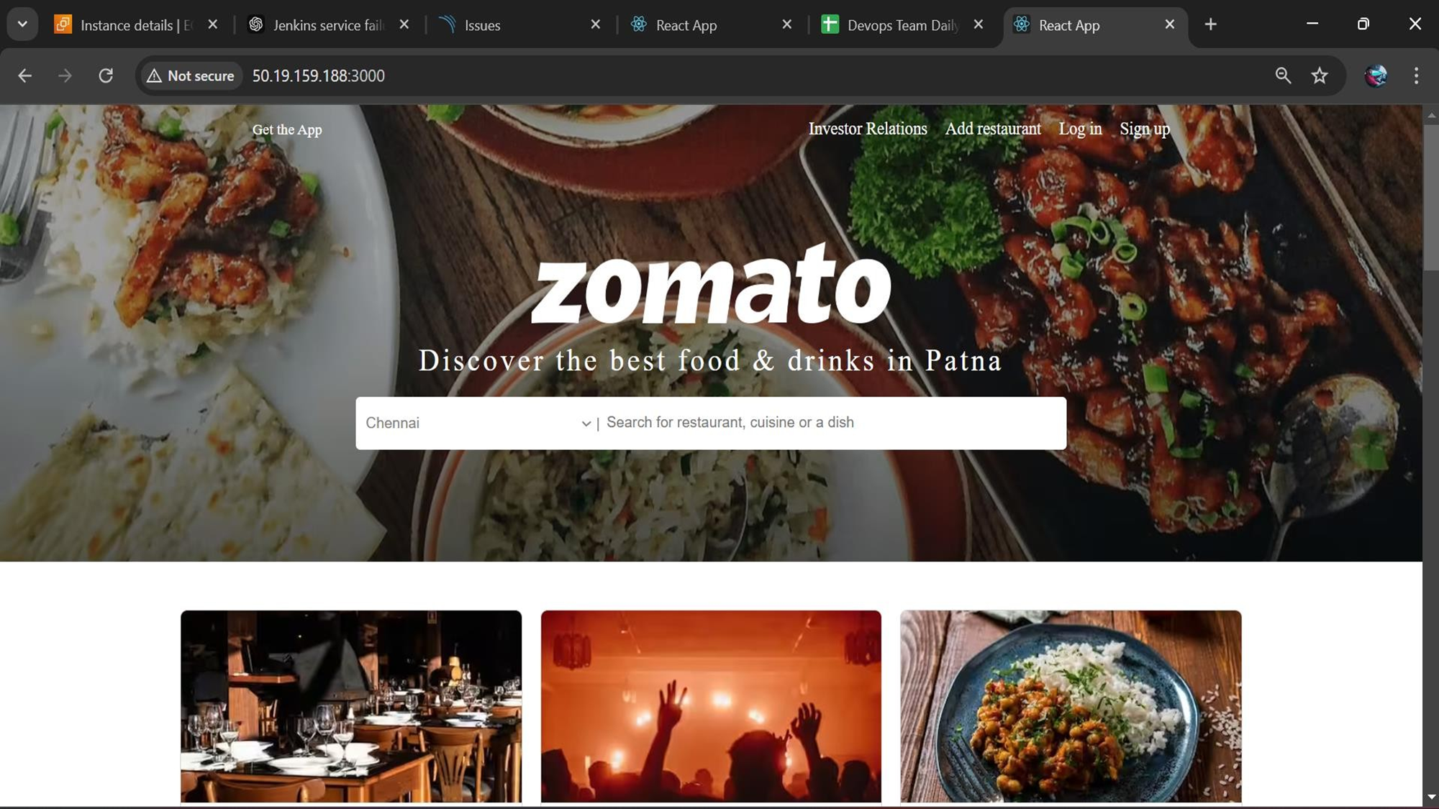

Slide 76


